Slide 1
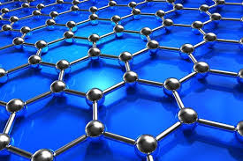
POLYMER CHEMISTRY AND ORGANOMETALLIC CHEMISTRY

Slide 2
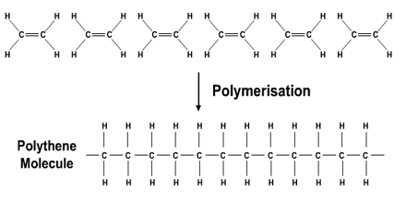
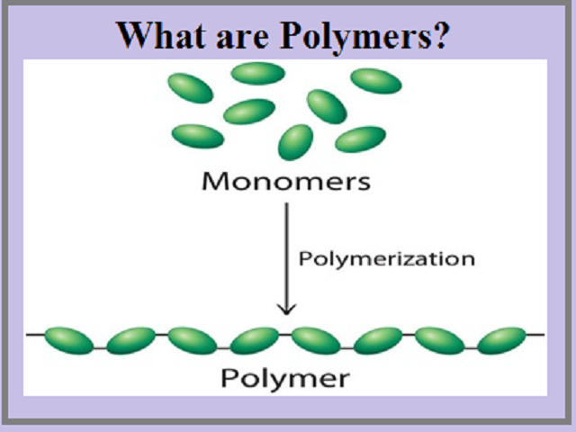
Polymer
The word ‘polymer’ is coined from two Greek words poly means many and mer means unit or part. The term polymer is defined as very large molecules having high molecular mass . These are also referred to as macromolecules.

Slide 3
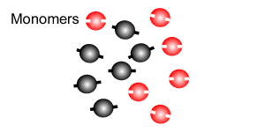
Monomer
The repeating structural units are derived from some simple and reactive molecules known as monomers and are linked to each other by covalent bonds. Ex- Ethene is the monomer of Polythene, Vinyl chloride is the monomer of PVC

Slide 4
Polymerisation
The process of formation of polymers from respective monomers is called polymerization.

Slide 5
Degree of Polymerisation (DOP)
The number of monomeric units combining in total to form the polymer is known as degree of polymerisation.
n(CH₂ =CH₂) --- (---CH₂ ---CH₂---) _{n}--
In above case the degree of polymerization (DP) = n, as ‘n’ monomers have joined to form the polymer.
3(CH₂ =CH₂) --- (---CH₂ ---CH₂---) ₃--
In above case the degree of polymerization (DP) = 3, as three monomers have joined to form the polymer.

Slide 6
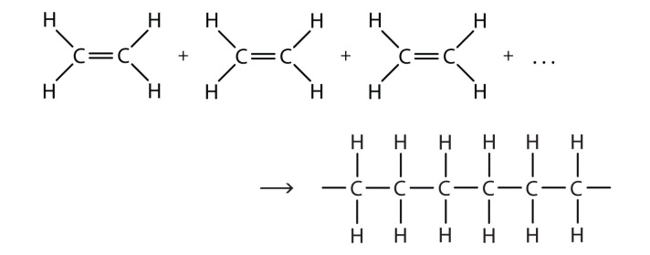
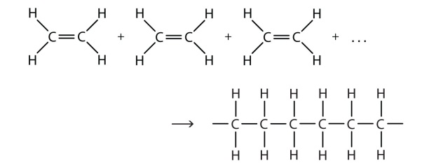
FUNCTIONALITY: The functionality of a monomer is the number of binding sites that is/are present in that monomer.
A molecule can act as a monomer only if it is at-least bifunctional in nature.
For example, the functionality of ethene is 2, since it can form two new bonds on breaking the existing pie bond.
Significance of functionality:
If, f = 2, a linear chain polymer is formed. E.G. ethene, ethylene glycol, hexamethylene diamine, adipic acid
If, f ˃ 2, branched or cross linked polymers are formed. E.g. glycerol

Slide 7
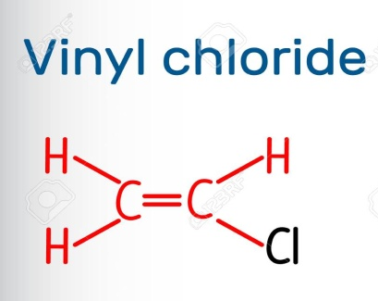
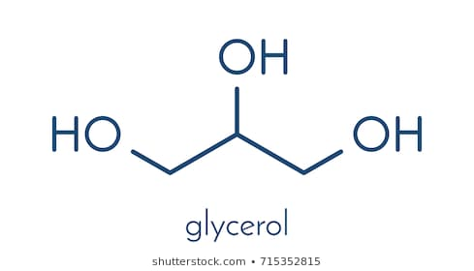
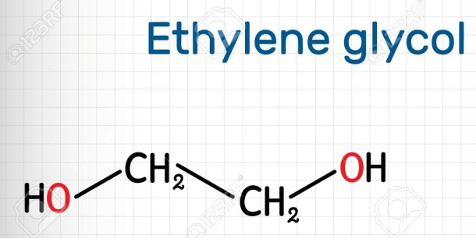
Example showing functionality
Compound | Chemical Formula | No. of Double bonds per molecule | Number of functional gps. present per molecule |  | Functionality
 |  |  | -OH | -COOH
Ethylene Glycol | C₂H₆O₂ | Nil | 2 | Nil | Bifunctional
Vinyl Chloride | C₂H₃Cl | 1 | Nil | Nil | Bifunctional
Glycerol | C₃H₇O₃ | Nil | 3 | Nil | Trifunctional

Slide 8
Characteristics of Polymers
All the polymers are macromolecules, but all the macromolecules are not polymers.
Polymers are semi crystalline material.
Low tensile strength , easy processibility.
Low density, high mould ability.
High resistance to degradation.
Generally insulators, few are conductors.
Have average molecular weight.
Polydisperse in nature.
Properties of polymers depend on their molecular weight, type of bonds between various chains.
Primary bonds (backbone) in polymers are covalent bonds whereas the secondary bonds (between chains) can be vanderwaals forces, dipole-dipole interaction or hydrogen bonds.

Slide 9
CONDITIONS FOR POLYMERISATION:
There are certain conditions that need to be fulfilled for a polymerization process to occur. Different polymers require different set of conditions which are :
Particular temperature and pressure.
Presence of a particular catalyst.
May or may not require an initiator.
*A catalyst alters the rate of reaction where as an initiator is required to start the reaction.

Slide 10
Why do polymers have average molecular weight?
Polymers are polydisperse in nature that means polymers are not composed of identical molecules.
When polymerisation starts, a number of polymer chains start growing but all of them do not start at the same moment or stop their growth at the same time. Hence polymer molecules differ in the number of monomer units joined to have different molecular weights. Therefore the polymer molecules in a sample are of same chemical type but of different DP, size and molecular weight.
In polymers all the chains have different molecular weight. For example, HDPE is made up of various long carbon chains, but the lengths of the chains may vary by thousands of monomer units. Because of this, polymer molecular weights are usually given as averages.

Slide 11
MOLECULAR WEIGHT DETERMINATION:
There are two ways to calculate the average molecular weight:
1. Number Average Molecular Weight (M̅n)
2. Weight Average Molecular Weight (M̅w)

Slide 12
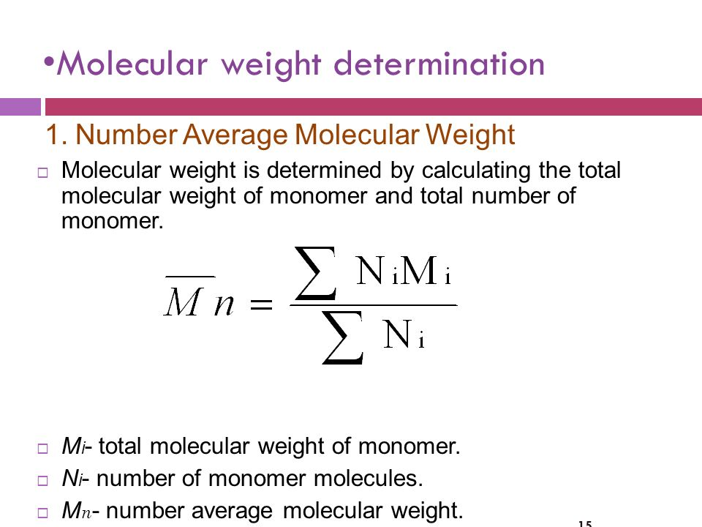
Number Average Molecular Weight
Molecular weight is determined by calculating the total molecular weight of monomer and total number of monomer.
= N₁M₁ + N₂M₂ + N₃M₃
N₁ + N₂ + N₃
• Mi- total molecular weight of monomer.
• Ni- number of monomer molecules.
• Mn- number average molecular weight.

Slide 13
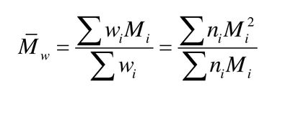
Weight Average Molecular Weight
= N₁M₁² + N₂M₂² + N₃M₃²
N₁M₁ + N₂M₂ + N₃M₃
Mw- weight average molecular weight.
Mi- total molecular weight of monomer.
Wi- weight of monomer molecules (W=nM)

Slide 14
POLYDISPERSITY INDEX (PDI)
The dispersity index, or formerly polydispersity index (PDI), or heterogeneity index, or simply dispersity (Đ), is a measure of the distribution of molecular mass in a given polymer sample.
PDI = M_{w} / M_{n}
where, M_{w =} weight average molecular weight
M_{n} ₌ is the number average molecular weight
NOTE: In the cases of monodisperse systems , PDI = 1, since M_{W} = M_{n} In most other cases , PDI > 1 or M_{W} > M_{n}

Slide 15
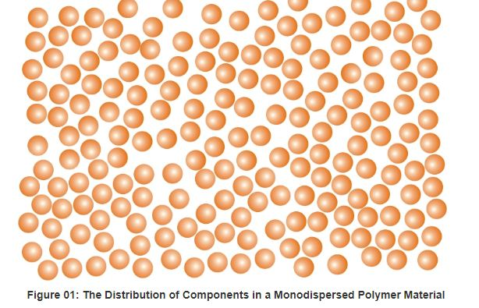
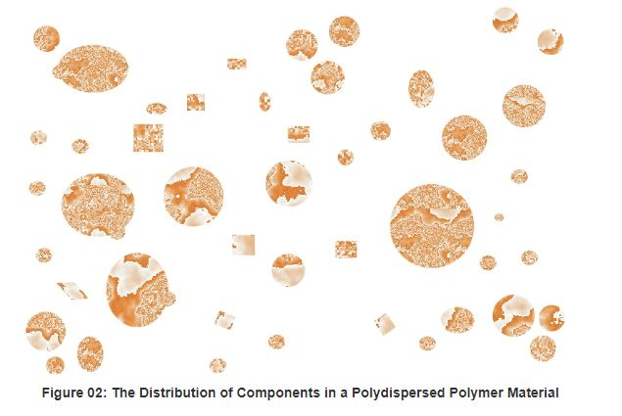
PDI = 1
PDI > 1

Slide 16
Q1. In a particular sample of a polymer, 100 molecules have molecular mass 10³ each, 200 molecules have a molecular mass of 10⁴ each and 200 molecules have molecular mass 10⁵ each. Calculate the number average and mass average molecular mass.
Sol.
= N₁M₁ + N₂M₂ + N₃M₃
N₁ + N₂ + N₃
= 100 x 10³ + 200 x 10⁴ + 200 x 10⁵
100 + 200 + 200
= 44,200
= N₁M₁² + N₂M₂² + N₃M₃²
N₁M₁ + N₂M₂ + N₃M₃
= 100 x (10³)² + 200 x (10⁴)² + 200 x (10⁵)²
100 x 10³ + 200 x 10⁴ + 200 x 10⁵
= 91,407.23

Slide 17
Q2. In a polymer, there are 100 molecules of molecular weight 100, 200 molecules of molecular weight 1000 and 300
molecules of molecular weight 10,000. Find out the number average and weight average molecular weight and polydispersity index.
Sol. Given: N₁= 100, M₁= 100, N₂= 200, M₁= 1000, N₃= 300, M₁= 10,000
Number average mol. Wt.
= N₁M₁ + N₂M₂ + N₃M₃
N₁ + N₂ + N₃
= 100 x 100 + 200 x 1000 + 300 x 10,000
100 + 200 + 300
= 10000 + 200000 + 3000000
600
= 3210000 / 600
= 5350

Slide 18
Weight Average molecular weight
= N₁M₁² + N₂M₂² + N₃M₃²
N₁M₁ + N₂M₂ + N₃M₃
= 100 x 100 x 100 + 200 x 1000 x 1000 + 300 x 10,000 x 10,000
100 x 100 + 200 x 1000 + 300 x 10,000
= 3.0201 x 10¹⁰
3210000
= 9408.4
Poly dispersity index
PDI = M_{w} / M_{n}
= 9408.4 / 5350 = 1.757

Slide 19
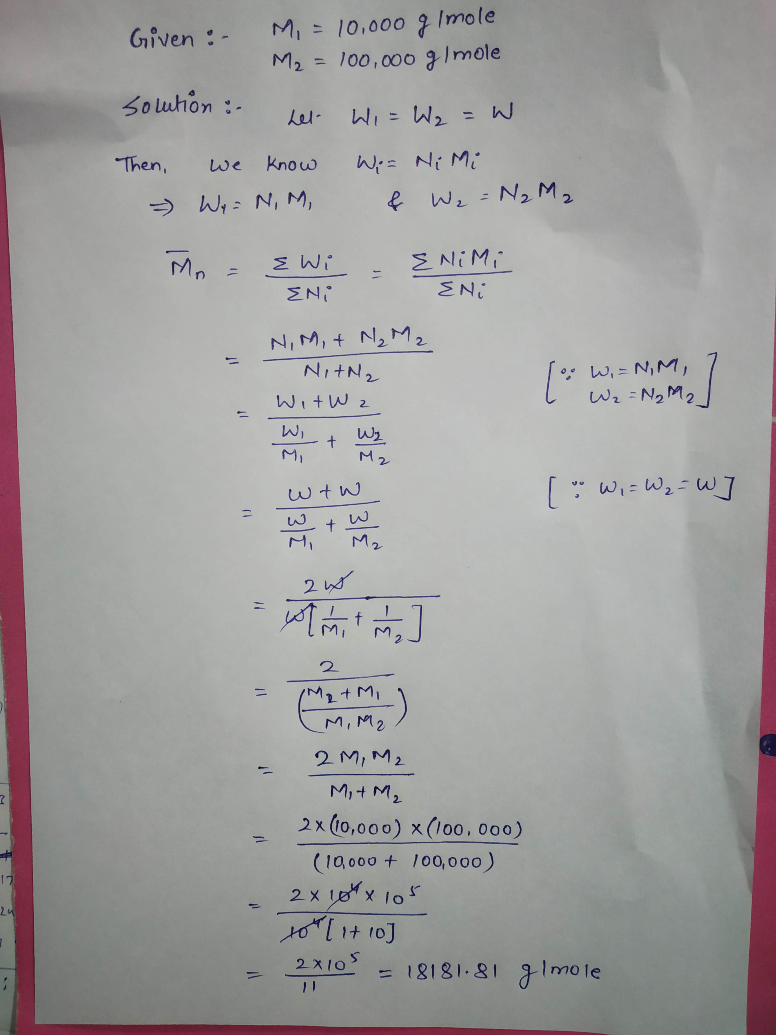
Q3. Equal weights of polymer molecules with M₁ = 10,000 g/mole and M₁ = 100,000 g/mole are mixed. Calculate number average molecular weight and weight average molecular weight.

Slide 20
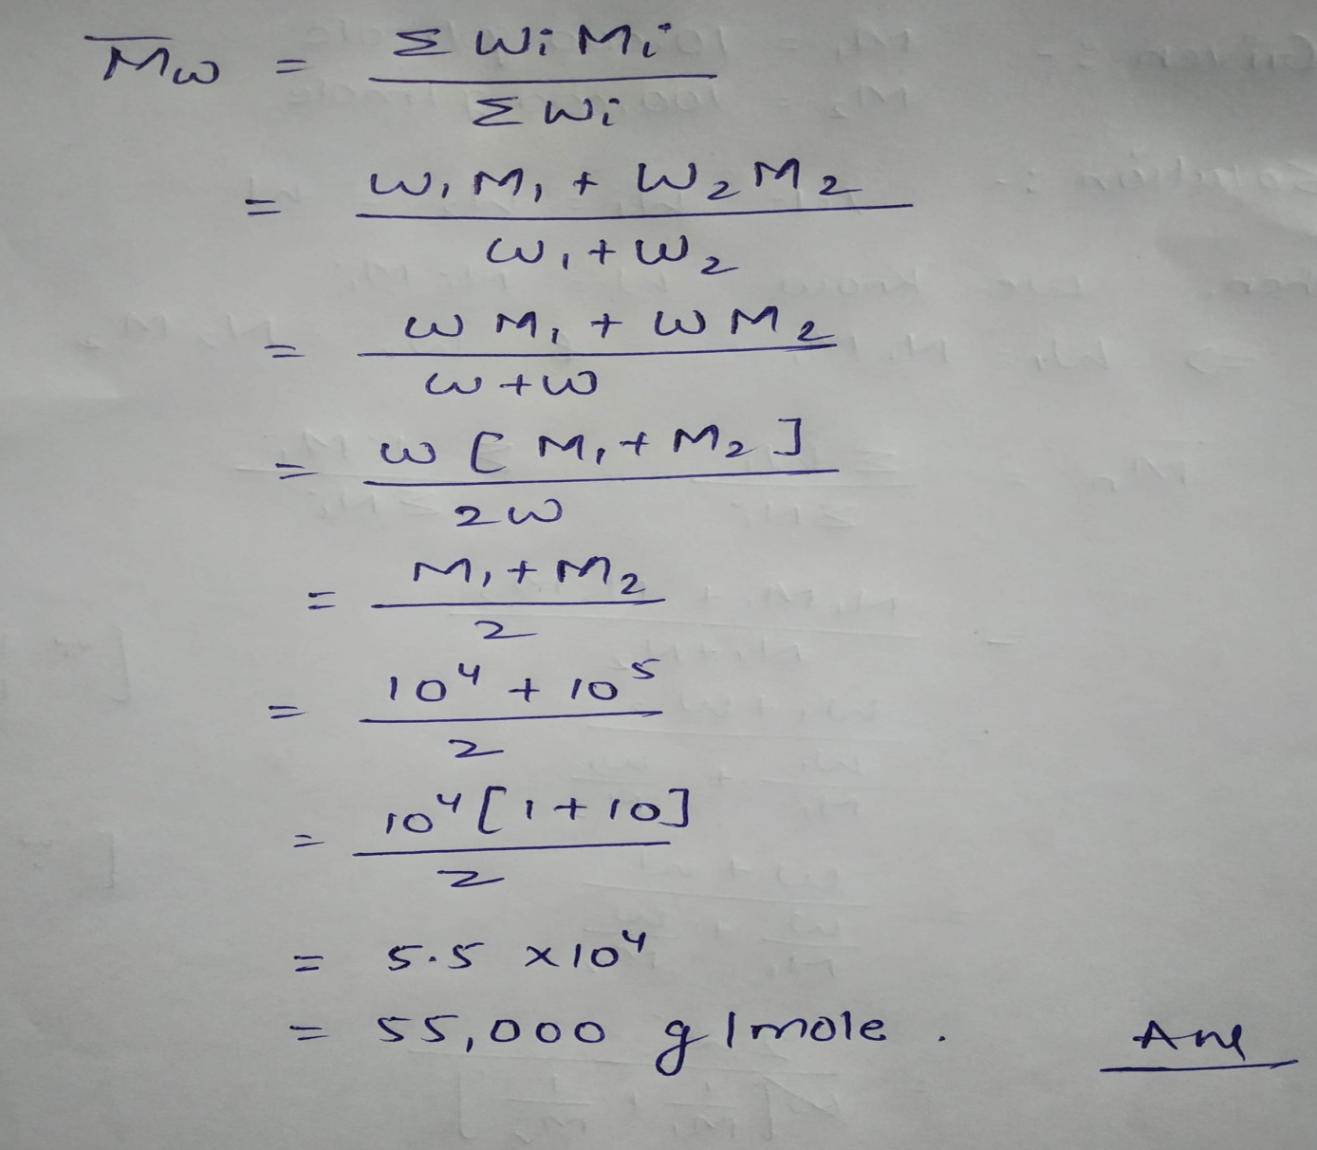

Slide 21
Classification of polymers

Slide 22
Classification of Polymer
4. By Mode Of Formation (polymerization)
1. By Origin
5. By Structure
2. By Monomer
6. By Tacticity
3. By action of heat
7. By Application & Physical Properties

Slide 23
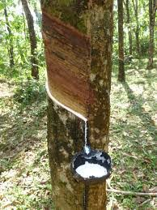
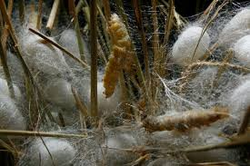
1. By Origin/occurance: Polymers can be divided into natural, semi synthetic and synthetic polymers on the basis of their origin.
a) Natural Polymers: Polymers which are isolated from natural materials, are called as ‘natural polymers’. E.g. : Cotton, silk, wool, rubber, natural rubber.

Slide 24
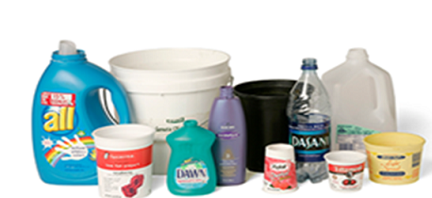
b) Synthetic polymers
Polymers synthesized in laboratories from low molecular weight compounds, are called as, ‘synthetic polymers’. E.g. polyethylene, nylon, terylene.

Slide 25
c) Semi-synthetic polymers
Semi synthetic polymers are those which are prepared from both man made and natural products. Like Rayon is prepared from the wood pulp and some man made products. Rayon is the first semi synthetic polymer in the world.
Cellulose derivatives as cellulose acetate and cellulose nitrate, etc. are the usual examples of this sub category.

Slide 26
2. On the basis of monomers
Polymers can be classified as homo-polymers and co-polymers on the basis of monomers.
HOMOPOLYMERS | COPOLYMERS
Polymers made up of same monomer units. | Polymers made up of two or more than two different monomer units.
Example: Polythene (Ethene), PVC(vinyl chloride) | Example: Buna-S (Butadiene+styrene), Nylon-6,6.(Hexamethylene diamine + adipic acid)

Slide 27
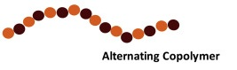
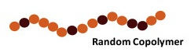
Copolymers are further divided into:
Alternating copolymers: Monomers are arranged alternatively in polymer chain. Ex: polyesters, polyamides.
b) Random copolymers: Monomers are arranged randomly in polymer chain. Ex: Buna-S

Slide 28
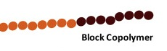
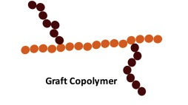
c) Block copolymers: One block of one type of monomer is followed by the block of other type of monomer. Ex: SBS rubber.
d) Graft copolymers: One type of monomer segment is grafted on the backbone chain of another type of monomer segment. Ex: High impact polystyrene.

Slide 29
3. Classification Based on Mode of Polymerisation
Polymers can also be classified on the basis of mode of polymerisation into two sub groups.
a) Addition polymerisation :
The addition polymers are formed by the repeated addition of monomer molecules possessing double or triple bonds, e.g., the formation of polythene from ethene and polypropene from propene.
However, the addition polymers formed by the polymerisation of a single monomeric species are known as homo polymers, e.g., polythene.

Slide 30
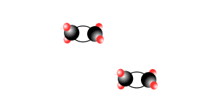
How Addition occurs?

Slide 31
b) CONDENSATION POLYMERISATION :
The condensation polymers are formed by repeated condensation reaction between two different bi-functional or tri-functional monomeric units.
In these polymerisation reactions, the elimination of small molecules such as water, alcohol, hydrogen chloride, etc. take place.
The examples are terylene (dacron), nylon-6,6, nylon-6,etc.

Slide 32
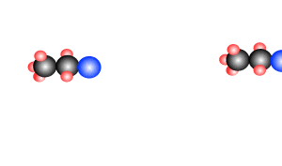
How actually condensation happens

Slide 33
Necessary condition for condensation polymerization
Presence of at-least two reactive functional groups in the monomers.
2. Condensation of monomers with the elimination of small molecules like water, CO₂, NH_{3.}
3. These reactions continue in step wise manner.
Example of condensation polymerization: Preparation of Nylon-6,6.

Slide 34
Condensation polymerisation | Additional polymerisation
(1) Also known as step growth polymerisation | (1) Also known as chain growth polymerization
(2) It takes place in monomers having reactive functional groups | (2) It takes place only in monomers having multiple bonds.
(3) It takes place with elimination of simple molecule like H₂O, NH₃, HCl etc. | (3) No elimination of simple molecule.
(4) Repeat units of monomers are different | (4) Repeat units & monomers are same.
(5) Also called step growth polymerisation. | (5) Also called chain growth polymerisation.
(6) The molecular mass of polymer increases throughout the reaction | (6) There is very little change in the molecular mass throughout the reaction
(7) Product obtained may be thermosetting/thermoplastic | (7) Product obtained are thermoplastic
(8) E.g.:- Bakelite, polyester ,polyamides etc. | (8) E.g:-Polyethylene, PVC, poly styrene.

Slide 35
4. On the basis of action of heat:
Classified as thermoplastic and thermosetting polymers.
Such polymer that soften on heating and stiffen on cooling are termed as `thermoplastic’ polymers. Ex. Polyethylene, PVC, nylon, sealing wax.
Polymer that becomes an infusible and insoluble mass on heating are called ‘thermosetting’ polymers.

Slide 36
Thermoplastic resins (or) Polymers | Thermosetting resins
(1) These are produced by additional polymerization | (1) These are produced by condensation polymerization.
(2) The resins are made of long chains attached by weak Vander Waal’s force of attraction | (2) The resins have three dimensional network structure connected bonds.
(3) On heating they soften and on cooling become stiff chemical nature won’t change | (3) On heating they become stiff & hard. No change on cooling. Chemical nature changes.
(4) They can be remoulded | (4) They cannot be remoulded because once set means they are permanently set
(5) Scrap (waste product) can be used | (5) Scrap cannot be used
(6) The resins are soft, weak and less brittle | (6) The resins are usually hard, strong tough & more brittle
(7) These are easily soluble in some organic substances E.g.:- PVC, polyethylene etc. | (7) Resins are not soluble in organic solvents E.g.:- Nylon, Bakelite etc.
(8) Contain long chain polymer with no cross linkage. | (8) They have 3D network structure.

Slide 37
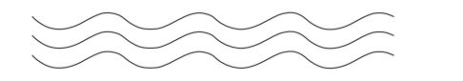
5. Classification Based on Structure
Linear Polymers
These polymers consist of long and straight chains. The examples are high density polythene, polyvinyl chloride, etc. These are represented as:

Slide 38
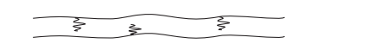
b) Branched chain polymers
These polymers contain linear chains having some branches, e.g., low density polythene (LDPE)

Slide 39
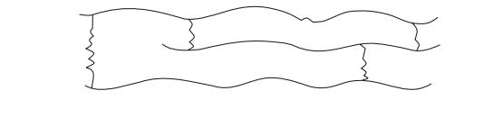
c) Cross linked or Network polymers.
These are usually formed from bi-functional and tri-functional monomers and contain strong covalent bonds between various linear polymer chains, e.g. bakelite, melamine, etc.

Slide 40
6. On the basis of tacticity:
Tacticity is defined as orientation or arrangement of side chains/groups on both the sides of main polymeric chain. On the basis of tacticity there are three types of polymers:
a) Isotactic: Functional groups on the same side of the main polymeric chain. Ex: Natural rubber (poly-cis-isoprene).
b) Syndiotactic: Functional groups arranged in the alternate fashion of the main carbon polymeric backbone. Ex: Gutta Purcha (poly-trans-isoprene).
c) A-tactic: Functional groups arranged in a random manner around the main carbon skeleton. Ex: Poly vinyl chloride.

Slide 41
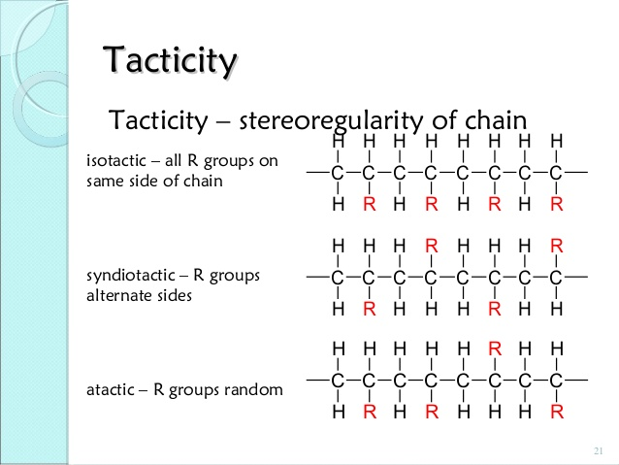

Slide 42
7. By application and physical properties: are classified as:
a) Plastics: All thermoplastic polymers are called plastics. They do not have cross linking. Ex- polypropylene (used for fibers and bottles), polystyrene (used to make Styrofoam cups)
b) Elastomers: These are rubber – like solids with elastic properties. In these the polymer chains are held together by the weakest intermolecular forces. Ex: Buna-S, Buna-N, neoprene etc.
c) Fibers: Fibers are long filament like material whose length is at least 100 times its diameter. They have high tensile strength. They have strong intermolecular forces like hydrogen bonding. Ex: polyamides (nylon 6, 6), polyesters (Terylene), etc.

Slide 43
Preparation, Properties and Uses of Some Industrially Important Polymers

Slide 44
Plastic :. a synthetic material made from a wide range of organic polymers such as polyethylene, PVC, nylon, etc., that can be moulded into shape while soft, and then set into a rigid or slightly elastic form
Bakelite: It is prepared by condensing phenol with formaldehyde in presence of acidic/alkaline catalyst. The initial reaction results in the formation of O- and P- hydroxyl methyl/phenol which reacts to form linear polymer. During modeling hexamethylene tetramine is added, which converts to insoluble solid of cross-linked structure Bakelite.

Slide 45
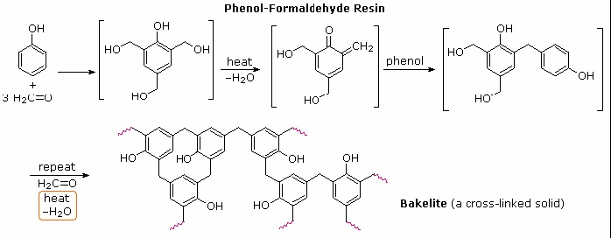

Slide 46
Properties:
It can be molded very quickly
resistant to heat,
resistant to electricity
Have lustre (shine).
Applications:
It is used for making electric insulator parts like switches, It is used for making electric insulator parts like switches
For making moulded articles like telephone parts cabinet of radio and television

Slide 47
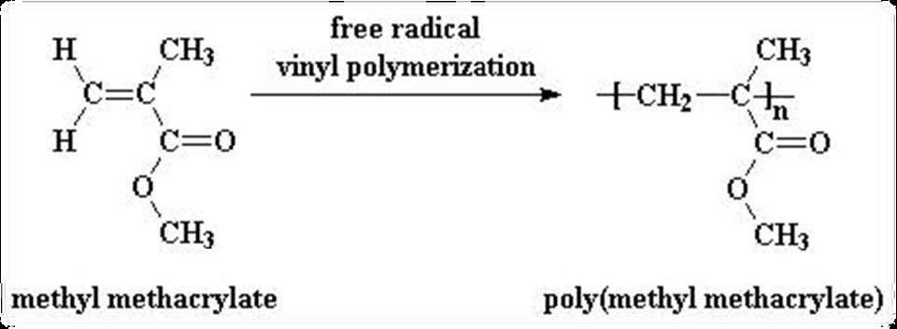
POLY METHYL METHACRYLATE (PMMA)
Preparation: Methyl methacrylate on polymerization in presence of a peroxide initiator gives poly methyl methacrylate (PMMA)

Slide 48
Properties:-
Plexi glass(PMMA) is a white transparent thermoplastic.
It has an excellent optical clarity, which is not affected by sunlight or age.
It has poor scratch resistance.
It is resistant to most of the chemicals but soluble in most of the organic solvents.
Application:-
widely used transparent plastic
Smart phone screens
car windows

Slide 49
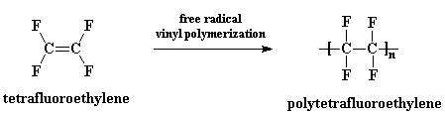
Teflon:
Teflon is obtained by polymerization of water-emulsion tetrafluoroethylene, under pressure in presence of benzoyl peroxide as catalyst.

Slide 50
Properties:
1. chemical-resistance towards all chemicals,
2. high density,
Applications:
insulating material for motors,
making gaskets, packing
for coating and impregnating glass fibres

Slide 51
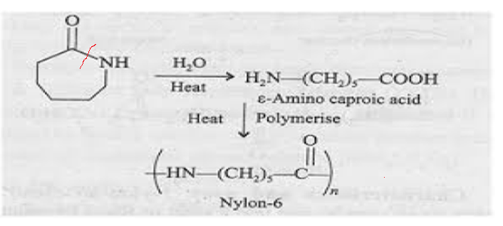
FIBRES: these are thin, long, thread like materials which have great tensile strength in the direction of fiber.
a) Nylon-6: Condensation polymerisation, Homopolymer, polyamide.
Preparation: Nylon-6 can be prepared by ring opening polymerization of Caprolactum.
caprolactum
Caprolactum

Slide 52
Properties:
Tough,
High tensile strength,
Elastic in nature,
Have lustre (shine).
Applications:
Gears, fittings, and bearings
Automotive industry.
As thread in bristles for toothbrushes, surgical sutures.
As strings in guitars, sitars, violins etc.
Making threads, ropes, filaments, nets, and tyre cords

Slide 53
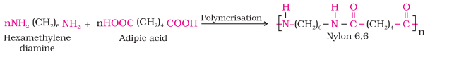
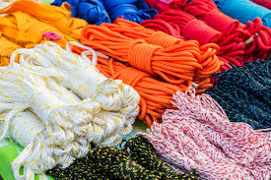
Nylon-6,6: Condensation polymerisation, Copolymer, polyamide.
Preparation: It can be prepared by poly-condensation of Adipic acid and Hexamethylene diamine
+ nH₂O

Slide 54
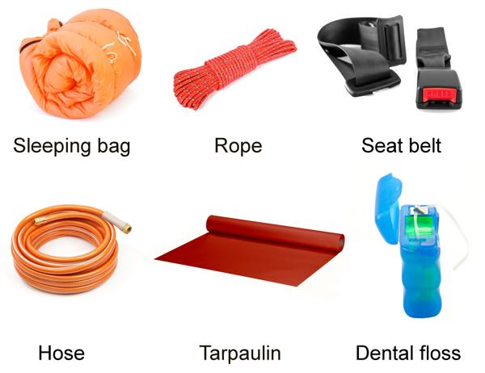
Properties:
Light weight
water resistant
High melting point.
Applications:
Used to make swim-wears, sleeping bags.
Used to make machine parts, seat belts.
Used to make airbags, socks, carpets, ropes etc.
Used in parachutes.

Slide 55
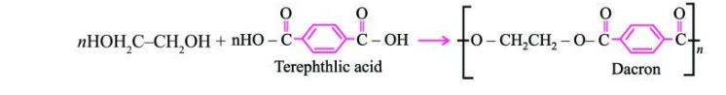
c) Dacron or Polyester (or) Terylene (or) Polyethylene Phthalate:-Copolymer, Condensation polymerisation, polyester.
Preparation: Terylene is a polyester fiber made from ethylene glycol and terephthalic acid.
+ nH₂O

Slide 56
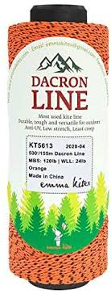
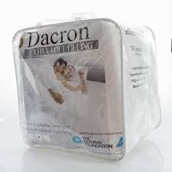
Properties:
Crease resistant, weightless.
It is highly resistant to mineral & organic acids.
Water resistant.
It has high melting point.
Applications:
Ropes
Nets
Thread
Raincoats
Fleece jackets, Quilts
Clothing
Medical textiles

Slide 57
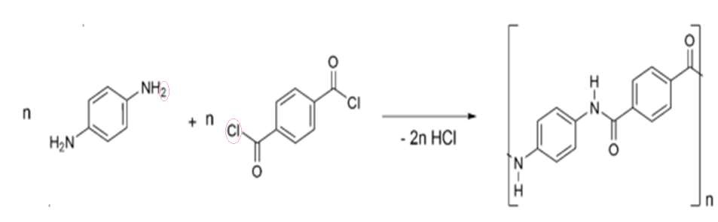
d) KEVLAR
Preparation: It is prepared by the condensation polymerization of
para-phenylenediamine and terepthaloyl chloride

Slide 58
Properties:
Kevlar is a very strong material – about five times stronger than steel.
Possess high tensile strength, low weight and high chemical inertness.
High cut resistant, fracture resistance and flame resistance.
Applications:
due to its high tensile strength-to-weight ratio; by this measure it is five times stronger than steel
heat- or flame-resistant fabrics
bulletproof clothing,
for aircraft panels
for aircraft panels

Slide 59
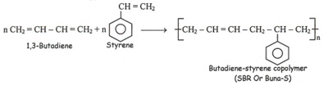
2. RUBBERS: is an elastomer that is, a polymer that has the ability to regain its original shape after being deformed.
Buna-S or SBR: (Elastomer):
Copolymer of 1,3-Butadiene (about 75% by weight) and styrene (25% by weight)
Preparation:

Slide 60
Properties:
High abrasion resistance
High load bearing capacity.
Swells in oils and solvents.
Applications:
Used in shoe heels and soles.
Used in chewing gum.
Used in making motor cycle and scooter tyres, cycle tyres and tubes.
Electrical insulation.

Slide 61
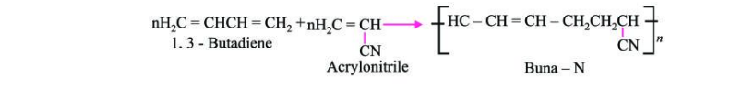
b) NBR or Buna-N or nitrile rubber:
Elastomer, copolymer
Preparation: Copolymer of Butadiene (about 75% by weight) and Acrylonitrile (25% by weight).

Slide 62
Properties:
Highly polar
Oil resistant.
Applications:
Conveyor belts.
Hoses, seals, gaskets.
Protective gloves in the nuclear industry tank lining
Adhesives

Slide 63
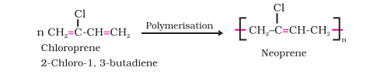
c) Neoprene (Elastomer):
Elastomer, copolymer
Preparation:

Slide 64
Properties:
1. Inert to chemicals.
2. Fire resistant.
3. Corrosion resistant.
4. Water resistant.
Applications:
1. Making gloves and coated fabrics.
2. Used in power transformers.
3. Used in wet-suits and diving-suits
4. Neoprene is also used for Halloween masks.
5. Lining of reaction vessels.

Slide 65
Condition for a polymer to be conducting in nature
CONDUCTING POLYMERS
Polymers that conduct electricity are known as conducting polymers.
These polymers show conductivity due to extensive conjugation in their backbone.
The polymer chain should contain conjugation (alternate sigma and pi bonds)through out its chain. So that there are resonating and mobile electrons for conduction.
Polymer should have high planarity in its structure.
Presence of aromatic rings in the chain with continuous resonance.
Polymer chain should be linear.

Slide 66
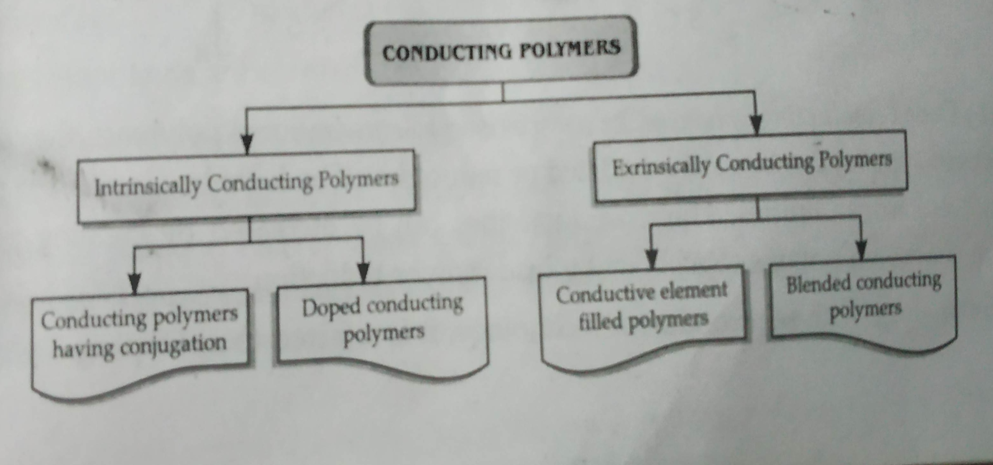
CLASSIFICATION:

Slide 67
Intrinsically conducting polymers:
These are the polymers which contain extensive pi-conjugation in the main chain and can conduct electricity either normally or on doping. They can be further classified as:
Conjugated conducting polymers
b) Doped conducting polymers

Slide 68
Conjugated conducting polymers:
These polymers contain conjugated pie bonds in their main polymeric backbone, which results in the formation of valence band and conduction band. There is movement of electrons due to conjugation making them conducting. Example: polypyrrole, polythiophene, polyacetylene, polyparaphenylene.

Slide 69
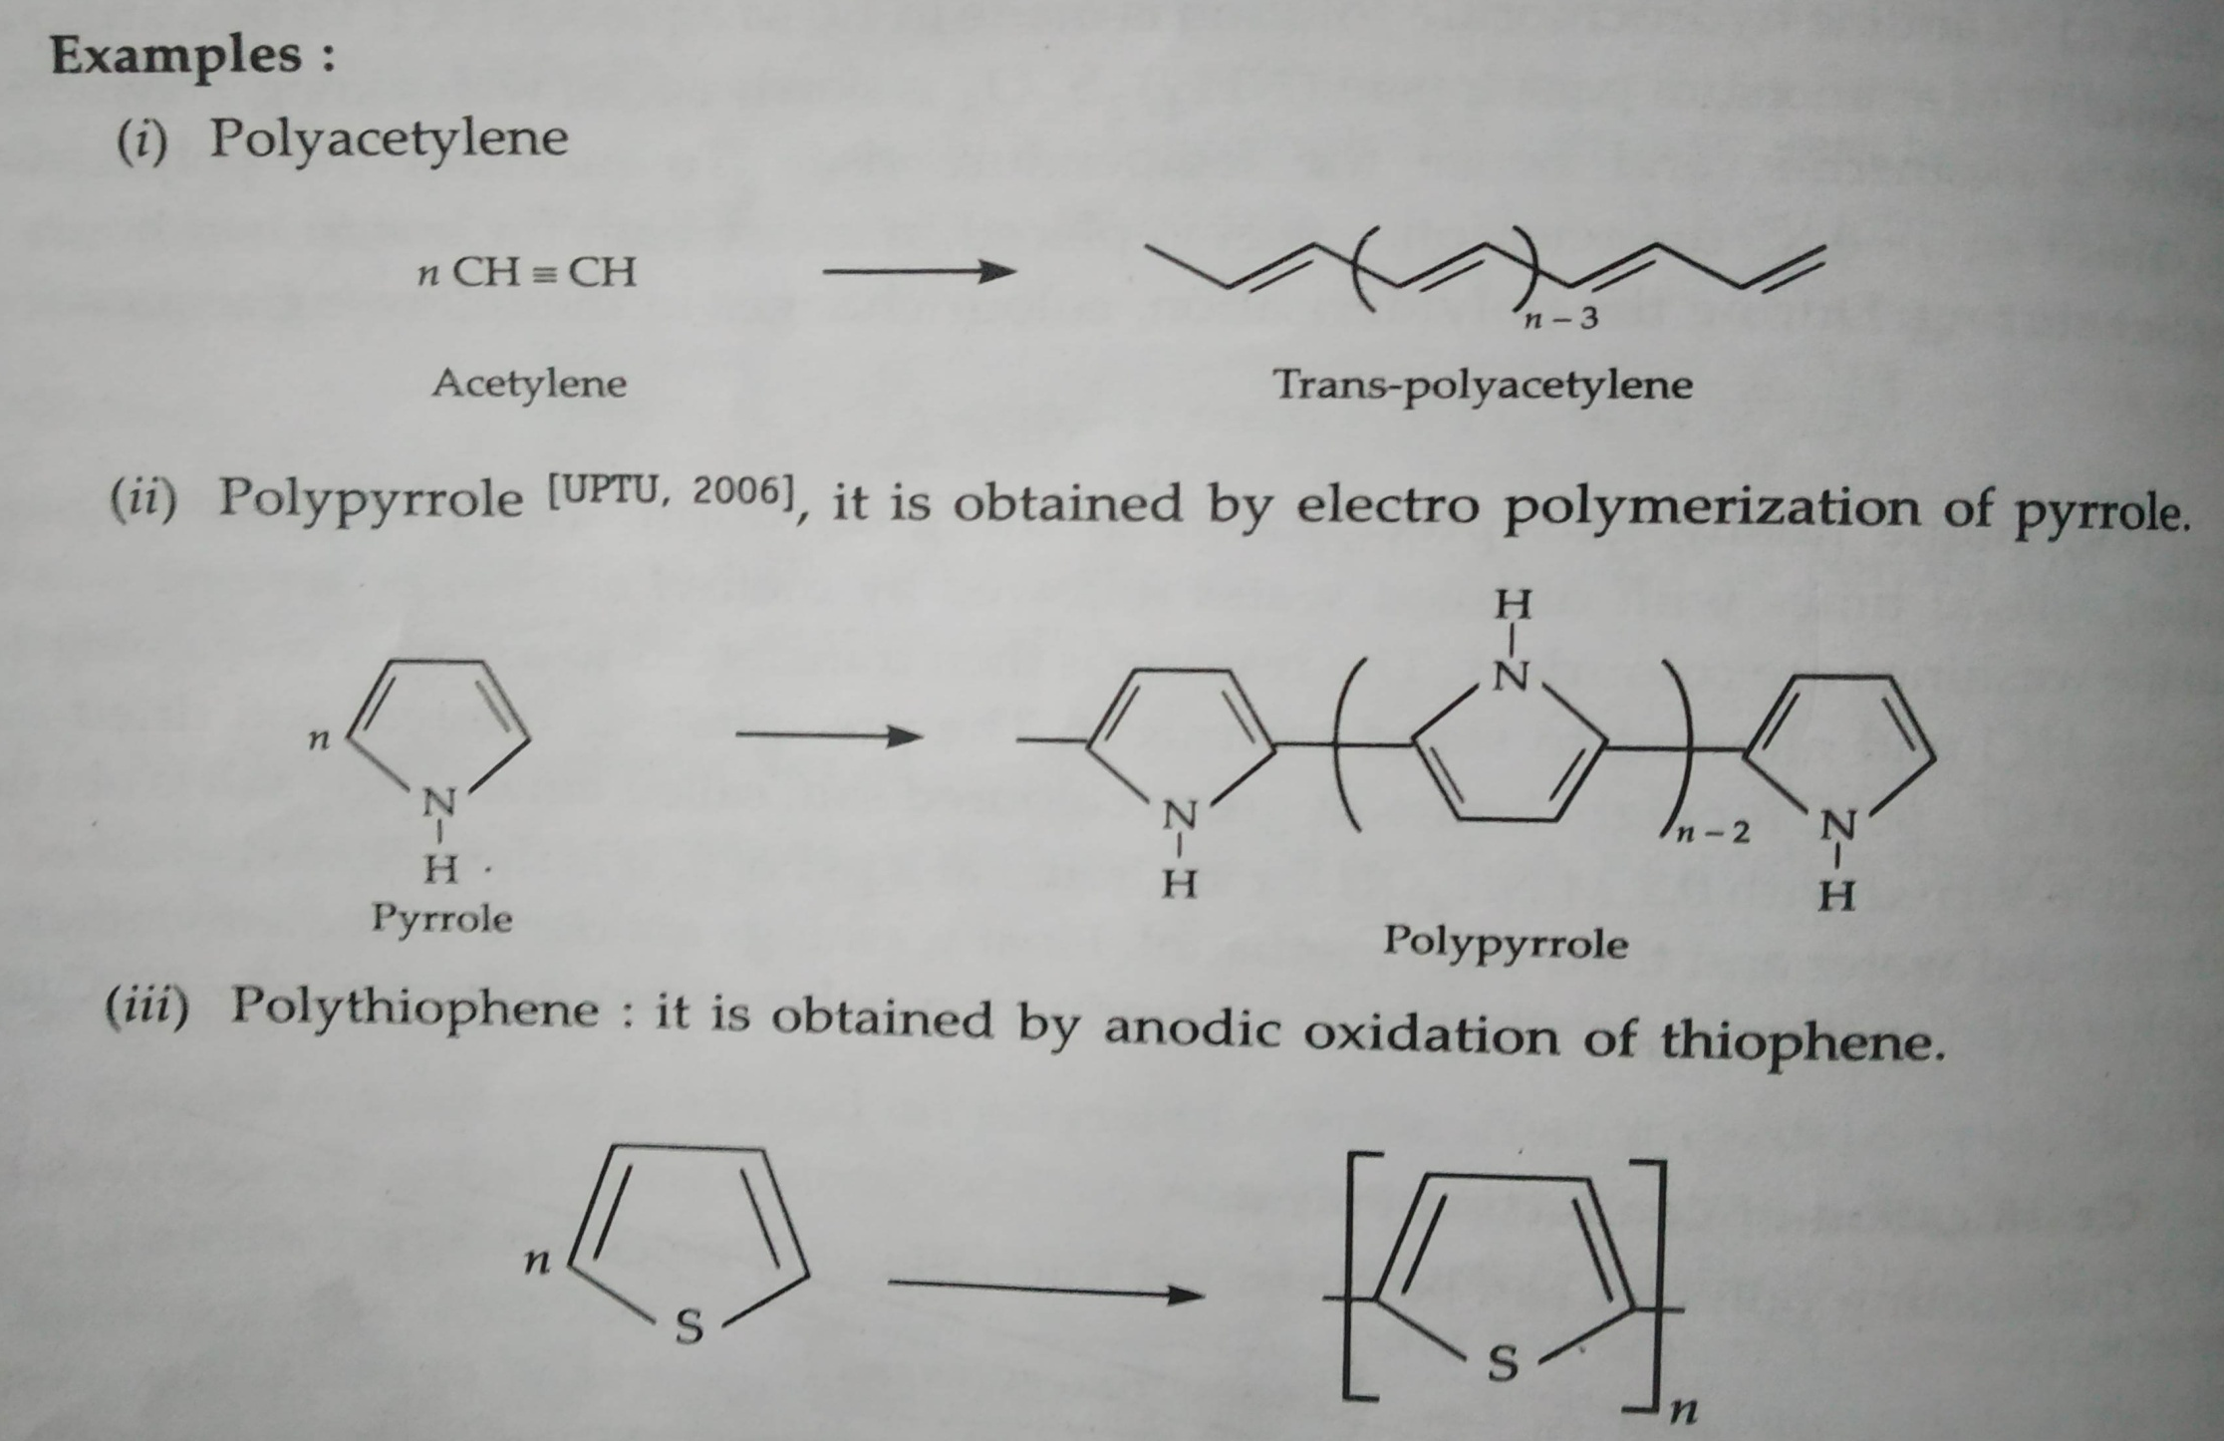

Slide 70
b) Doped conducting polymers:
i)These are the polymers which have conjugated pie bonds but have gap between valance and conduction band and cannot conduct electricity normally.
ii) They are doped with electron donor or electron acceptors to make them conducting.
Doping can be done by:
p-Doping:
n-Doping:
Done by removal of electron from backbone.
This is done by using lewis acid as FeCl₃

Slide 71
a) P-doping:
i) Done by removal of electron from backbone.
ii) This is done by using lewis acid as FeCl₃
(CH)_{x} + A ^{oxidation} (CH)_{x}⁺ A⁻
Acetylene Lewis Acid
b) n-Doping:
i) Done by addition of electron in the backbone.
ii) This is done by using lewis base as Na, Li .
(CH)_{x} + B ^{reduction} (CH)_{x}⁻ B⁺
Acetylene Lewis Base

Slide 72
2. Extrinsic polymers: These are the polymers that do not contain the factors responsible for conduction and are made conducting by adding external ingredients in them.
a)Polymers with conducting element:
Conductive elements such as carbon black, metal oxide are added to polymer.
Polymer acts as binder and hold these elements and thus acts as conductive polymer.
b) Polymers with Conducting blend or Blended conducting polymer:
Blending a conventional polymer with conducting polymer takes place.
Conventional polymer gains the conducting property.

Slide 73
Applications of conducting polymers
Rechargeable batteries: Doped conducting polymers are used as promising charge storage material. They are small sized, long lasting and can produce high current density (50 mA/cm²). They have high charge to weight ratio.
As antistatic material: To avoid static electricity in plastic carpets in offices, theatres, doped polyaniline can be used as antistatic material.
Optical filters: Radiations from computer screens, other electrical devices can be absorbed by conductive polymers by coating on casing.
Sensors: The conductive polymers have chemical properties suitable to use them as sensors form pH, O₂, NO₂, SO₂, NH₃ , glucose, reducing and oxidising chemicals, for the study of their even low concentrations.

Slide 74
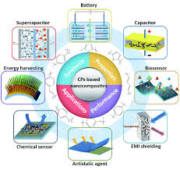
In electronics: They are used for photodiodes, light emitting wall papers, light emitting diodes (LED) and data storage.
Photovoltaic cells: The conductive polymers can be used in construction of photovoltaic cells like –Al / conducting polymer / Pt. ⁺
In telecommunication systems.
In molecular wires and molecular switches.
In electromagnetic screening materials.

Slide 75
BIODEGRADABLE POLYMERS:
The polymers which can degrade in nature by the action of enzymes and microbes are known as biodegradable polymers.
Functional Groups generally used in preparation of biodegradable polymers Ether, Esters, Amides
FACTORS AFFECTING BIODEGRADATION:
Size and shape: Polymers should not be very large and should not be too much branched.
Crystallinity: Polymers should be semi crystalline. The percentage if crystallinity should be less.
Hydrophillicity: for biodegradation polymers should be water soluble.
Presence of functional groups: Polymers should be having biodegradable functional groups. Polymers based only on carbon atoms are non-biodegradable.
Presence of suitable microorganism.
Presence of favourable conditions like suitable temperature, moisture, pH for proper functioning of micro-organism.

Slide 76
BIODEGRADATION PROCESS:
STEP- 1 ^{ST}: The long polymer molecules are reduced to shorter and shorter lengths and undergo oxidation. The molecules become hydrophilic (water attracting) and small.
STEP 2ND: Biodegradation starts in the presence of moisture and micro-organisms found in environment.
The plastic material is completely broken down in to the residual products of the biodegradation process.
STEP 3RD: As micro- organism consume the degraded plastic, carbon dioxide, water and biomass are produced and returned to nature by way of the bio cycle.

Slide 77
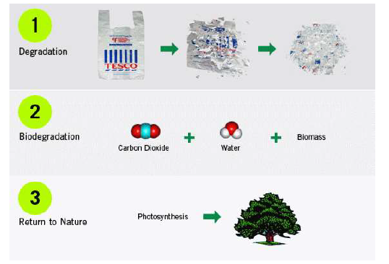

Slide 78
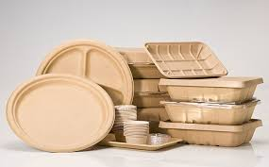
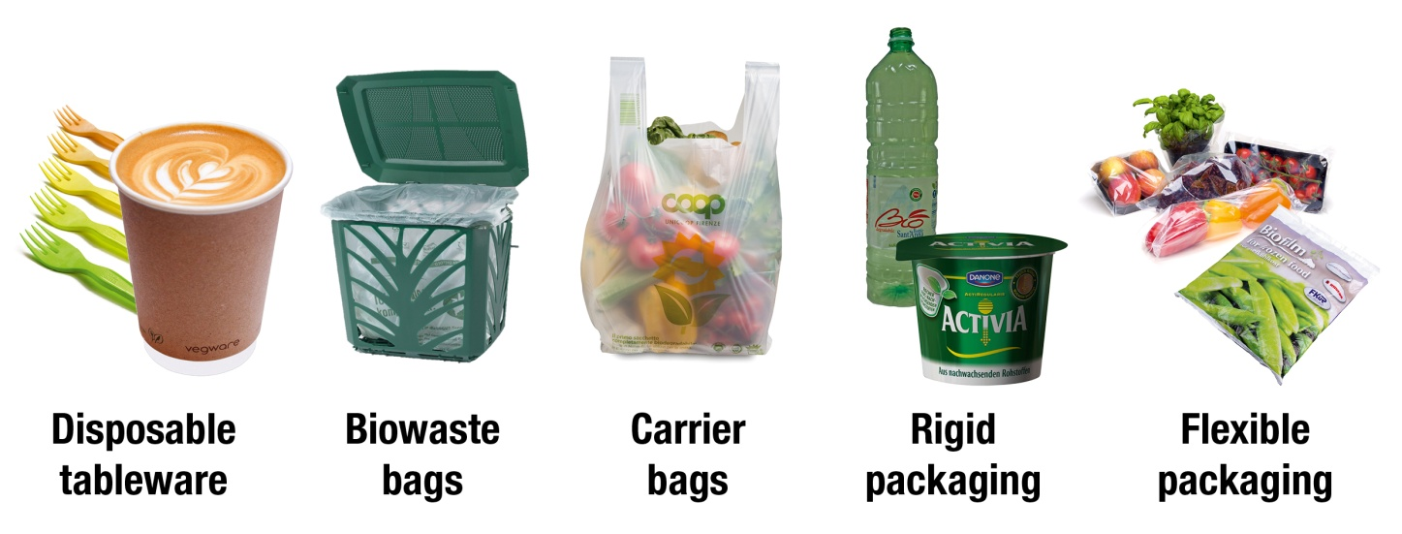
Importance of biodegradable polymers:
Improper disposal and failure to recycle results in overflowing landfills.
Produced from renewable resources.
Able to be recycled, burned without producing toxic products.
Used in localized delivery of drugs.
Reduce side effects.
Controllable degradation rate.

Slide 79
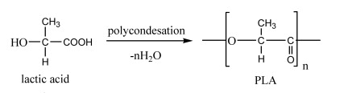
Formation, properties and uses of some biodegradable polymers:
a). Poly(lactic acid):
Formed by polymerisation of lactic acid.
Properties:
PLA is compostable and biodegradable.
It is resistant to grease and moisture.

Slide 80
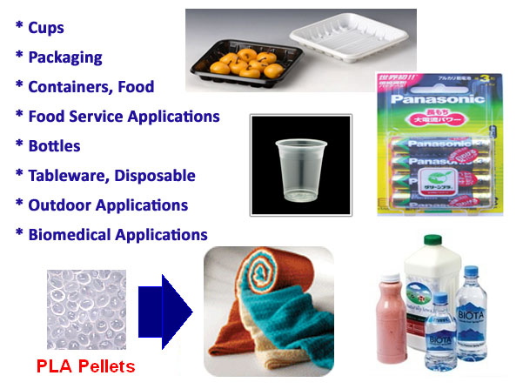
Uses:
PLA is used in plastic surgery.
It is used in food packaging.
Used for surgical sutures.
Used in drug delivery systems.

Slide 81

b). Poly glycolic acid:
It was the first synthetic absorbable suture.
Properties:
1. PGA is highly crystalline.
2. It has a high melting point.
3. Has low solubility in organic solvents.

Slide 82



Uses:
This polymer was used to develop the first synthetic absorbable suture which was marketed under the trade name of Dexon.
1. Used in tissue engineering.
2. Used in controlled drug delivery
3. Used as biodegradable sutures.

Slide 83

c). Poly-ß-hydroxybutyrate-co- ß-hydroxyvalerate
(PHBV) or (BIOPOL) or (BIOMER-L)
Properties:
PHBV is a thermoplastic polymer.
It is brittle.

Slide 84



Applications:
1. In controlled release of drugs.
2. Medical implants and repairs.
3. Orthopedic devices.
4. Manufacturing bottles of shampoos etc.

Slide 85

d). Nylon-2-nylon-6 :
Properties:
It is a polyamide and copolymer of glycine (H₂N-CH₂-COOH) and amino caproic acid (H₂N-(CH₂)₅COOH)
It is biodegradable.

Slide 86


Uses:
Used to make ropes and parachutes and tooth brush bristles.
Nylon is also used as dressing material in shirts etc.

Slide 87

COMPOSITES:
Composite material is a material composed of two or more phases (matrix phase and dispersed phase) and an interface separating them.
Their bulk properties are different from those of any of the constituents.

Slide 88
Matrix Phase | Dispersed or Reinforcing Phase
It is primary phase | It is secondary force
It is in continuous form | It is in discontinuous form
It holds the dispersed phase and shares load with it. | It is embedded in matrix
Weaker than dispersed phase. | Stronger than matrix phase
Classification of composite materials:
There are two classification systems of composite materials:
Based on matrix phase.
Based on reinforcement phase.
On the basis of number of Ply or Lamina’s or layers

Slide 89
a) Classification based on the basis of type of matrix
Polymer matrix composite | Metal matrix composite | Ceramic metal composite
1.The matrix is made of polymer. | 1. Matrix is made of metal. | 1. Matrix is a ceramic material.
2. Low cost | 2. High cost | 2. High cost
3. Low density | 3. High density | 3. High density
4. Low thermal stability | 4. Resist thermal shock | 4. High thermal stability

Slide 90

b) Classification based on the basis of type of Reinforced Material used in the matrix

Slide 91
c) On the basis of number of Ply or Lamina’s or layers
(i) Unidirectional Fibre Reinforced Composite : They are most widely used composite materials. They usually consist of several distinct layers of unidirectional composites. Unidirectional composite in turn, consist of parallel fibres embedded in a matrix. Each layer of unidirectional composite is known as layer, ply or lamina. Each lamina is generally made of same constituent materials (e.g. Matrix and fibre). But an individual lamina may differ from another lamina in
Relative volumes of fibre and matrix
orientation of fibres with respect to common reference axes and
Form of the reinforcement used such as woven or non woven reinforcement , continuous and discontinuous fibres.

Slide 92
b) Laminar: It is composed of two-dimensional sheets or panels that have a preferred high strength direction such as is found in wood and continuous and aligned fiber-reinforced plastics. The layers are stacked and cemented together such that the orientation of the high-strength direction varies with each successive layer. One example of a relatively complex structure is modern ski and another example is plywood.

Slide 93

c). Sandwich Panels: Consist of two strong outer sheets which are called face sheets and may be made of aluminum alloys, fiber reinforced plastics, titanium alloys, steel. Face sheets carry most of the loading and stresses. Core may be a honeycomb structure which has less density than the face sheets and resists perpendicular stresses and provides shear rigidity. Sandwich panels can be used in variety of applications which include roofs, floors, walls of buildings and in aircraft etc.

Slide 94

Advantages of composite materials:

Slide 95
APPLICATIONS:
These composites make for a great building material for airplanes and spacecraft.
Automotive manufacturing and railway industries in the form of dashboards, car covers, engine covers, car floors, and seats.
light houses, hydraulic construction, storage tanks, and door and window components.
For reconstruction and repair infrastructure.

Slide 96
POLYMER BLENDS
Polymer Blend is a mixture of two or more than two polymers, having physical properties different from the component polymers.
The components of polymer blend should be friendly with each other.
Blending is done to improve the properties of components.
Example: Mixture of wool and terylene forms a polymer blend.
Wool (-CONH-) + Terylene (-COO-) polymer blend.

Slide 97
Types of polymer blends:
1. Miscible polymer blend:
Homogenous
Negative value of the free energy of mixing
It is a single –phase structure.
Has one Tg. (Tg = glass transition temperature).
Example PS/PPO

Slide 98
Tg(Transition glass temprature):- Glass Transition Temperature (is the point at which a material goes from a hard brittle state to a soft rubbery state. Amorphous polymers only have a Tg.
Some polymers are used above their glass transition temperatures, and some are used below. Hard plastics like polystyrene and poly(methyl methacrylate), are used below their glass transition temperatures; that is in their glassy state. Their Tg's are well above room temperature, both at around 100 ºC. Rubber elastomers like polyisoprene and polyisobutylene, are used above their Tg's, that is, in the rubbery state, where they are soft and flexible.

Slide 99
2. Immiscible polymer blend:
Heterogeneous
Positive value of the free energy of mixing
Has two Tg’s (glass transition temperature).
Example PA(Polyamide)/PPO (Poly phenylene Oxide ), PA(Polyamide)/ PP(Polypropylene )
3. Homologous polymer blend:
Mixture of same polymers with different molecular weight distribution. e.g., PP (Polypropylene) / PA-6(Polyamide-6 or Nylon 6)

Slide 100
4. Isomorphic polymer blend:
Polymer blends of two or more different semi-crystalline polymers. Ex:- Polyketone polymer blend of a polyketone copolymer with a Polyketone terpolymer
5. Compatible polymer blend:
Blends that are miscible in a certain range of composition and temperature, but immiscible in others. Example: PC(Polycarbonate )/ABS(Acrylonitrile butadiene styrene)

Slide 101
Methods of polymer blending:
Generally, blending methods are:
Mechanical mixing-cheapest
Melt mixing
Fine powder mixing
Use of monomer(s) as solvent for another component, then polymerization.
Solution mixing

Slide 102
Advantages of blending:
Producing materials having desired properties at lowest cost.
It improves solvent and chemical resistance.
It improves flame resistance.
Recycling of industrial and municipal plastics waste.
Blending reduces the material cost.
Enables to produce materials with higher aesthetic value.

Slide 103
Ziegler-Natta Catalysts
Combination of a transition metal compound of an element from groups IV to VIII, and an organometallic compound of a metal from groups I to III.
Catalyst – Transition metal
Co-catalyst – Organometallic Compound, mainly alkyl or alkyl halides of aluminium and boron, or methylaluminoxane.
Ziegler-Natta catalysts are prepared by reacting certain transition metal halides with organometallic compounds. Ex: TiCl₄ (transition metal halide) and Al(C₂H₅)₄ (organometallic compound

Slide 104

Structure of Zeigler Natta Catalyst

Slide 105

Co-ordination Polymerisation or Ziegler-Natta Catalytic Polymerization or Heterogeneous catalysis

Slide 107


Slide 108

Significance of Zeigler Natta Catalyst
Used to produce linear polymers, without branching. E.g. HDPE

Slide 109

2. To produce Isotactic polymers.

Slide 110

3. To produce stereo-regular and stereo-selective polymers.

